Slide 1


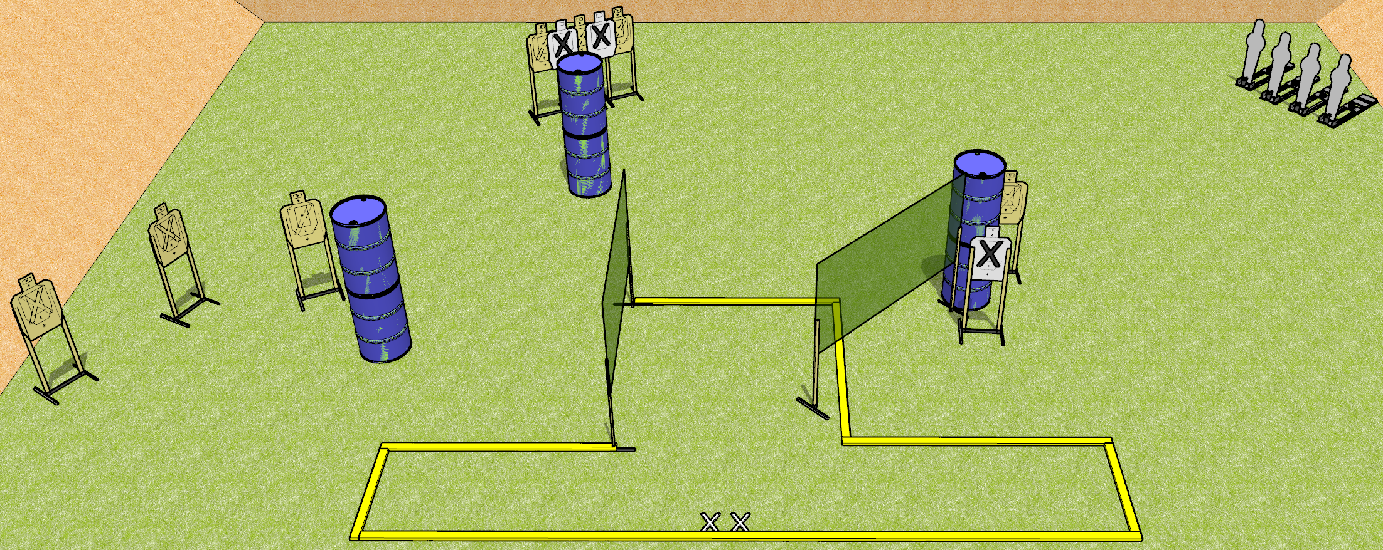
 | Dothan Gun Club – USPSA Match Almost a Dan Stage Course Designer : Drew Coleman
START POSITION : Standing with both feet on X’s
GUN READY CONDITION : Pistol loaded and holstered. PCC shouldered pointed at ground within the fault lines |  | SCORING: Comstock, 18 rounds TARGETS: 7 paper, 4 Steel SCORED HITS: Best 2 on paper, steel until down START-STOP: Audible, last shot RULES:
STAGE PROCEDURE: Engage targets as they become available from within the fault lines

